Slide 1
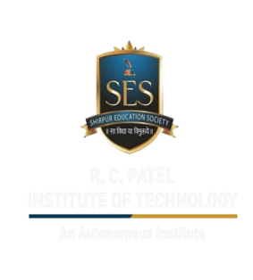
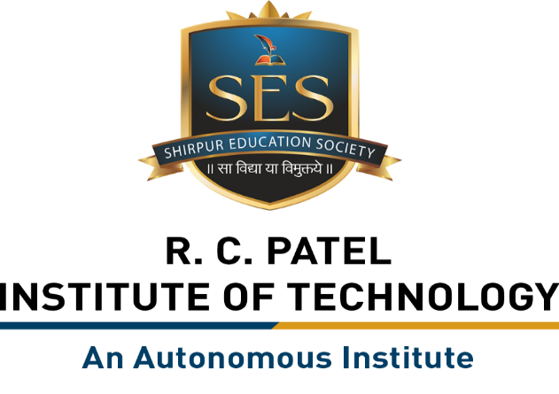
Major Project
“PSID-1604_Conversational Image Recognition Chatbot”
By
1.Dusane Durgesh Vijay (PRN:211106051_Roll No_05)
2.Chaudhari Siddhesh Ashok (PRN:221106061 _Roll No_59)
3.Naik Akshata Vishal (PRN:231206006_Roll No_67)
4.Chaudhari Vaishnavi Narendra (PRN:231206007_Roll No_68)
Department of Computer Science and Engineering(Data Science)
The Shirpur Education Society’s
R. C. Patel Institute of Technology, Shirpur - 425405.
[2025-26]

Slide 2
Outline
Introduction
Project Objectives
Existing System survey
Software and Hardware Requirements
Methodology
Working
Future Scope
Conclusion
Reference

Slide 3
.
Introduction
A Conversational Image Recognition Chatbot is a system that combines image recognition and chatbot technologies.
It can analyze and understand images sent by users, then provide information or answer questions about them through conversation.
For example, if you send a picture of a flower, the chatbot can identify it and tell you its name and details.
This makes it a powerful tool for tasks that involve both images and communication.

Slide 4
Objectives
Understand Images: Recognize and analyze images sent by users.
Talk to Users: Have conversations with users about the images.
Provide Help: Offer useful information based on the images.
Easy to Use: Make it simple for users to send pictures and get answers.
Better Experience: Improve the way users get information through images and conversation.

Slide 5
.
.
Existing System Survey
Basic Image Recognition: Some systems recognize images but don’t provide detailed conversations.
Text-Based Chatbots: Chatbots answer text questions but don’t analyze images.
Slow Responses: Some systems take time to process images and respond.
Manual Inputs: Users sometimes need to describe images, making it less convenient.

Slide 6
Hardware And Software Requirement
Software Requirements:
1. Operating System: Windows 10/11
2. Programming Language: Python
3. Frameworks & Libraries:
TensorFlow / PyTorch:
OpenCV:
text.Flask / Django:
4. Database: MySQL, Firebase, or MongoDB for storing data.
5. IDE/Tools: Jupyter Notebook, VS Code, or Google Colab.
Hardware:
1. Processor: Intel Core i5 or Ryzen 5
2. RAM: Minimum 8GB (16GB or more for smoother, faster processing).
3. Storage: 256GB SSD (512GB SSD or more is preferred for quick data access).
4. Camera: Built-in or external camera for capturing real-time images (optional, depending on the use case).

Slide 7
Methodology
Image Processing: Use deep learning models (e.g., CNNs, Vision Transformers) for object detection.
Natural Language Processing: Implement NLP techniques (e.g., transformers, GPT) to generate responses.
Integration: Combine image recognition and conversational AI to generate meaningful interactions.
Training & Testing: Train models using labeled datasets for accurate recognition and response generation.

Slide 8
Working
Image Upload: User sends an image to the chatbot Image.
Recognition: Chatbot analyzes the image to identify objects using deep learning.
Natural Language Processing (NLP): Chatbot understands the user's text input.
Response Generation: Chatbot creates a response based on the image and text.
Interaction: Chatbot sends the response and continues the conversation.
Backend & Data: User interactions and data are stored in a database.

Slide 9
Future Scope
Better Accuracy – Improve AI models to recognize more objects.
Voice Interaction – Enable full voice-based conversations.
Multilingual Support – Allow chatbot to respond in different languages.
Mobile App Development – Make it accessible via smartphones.

Slide 10
Conclusion
Conversational Image Recognition Chatbot combines image recognition and text-based conversation to provide users with interactive and helpful responses. By analyzing images and understanding text, it can offer meaningful information, making it a useful tool for various tasks like customer support, education, and more.

Slide 11
Reference
Chen, Q., Yu, Z., & Zheng, K. (2024). Conversational Image Recognition Using Deep Learning Models. Journal of Artificial Intelligence Research.
Zhao, C. (2023). A Chatbot-Based Image Recognition System for Smart Applications. International Journal of Computer Vision.
.

Slide 12
THANK YOU!!!

